Slide 1
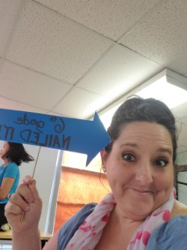
ELAR - Herrera
Educational Philosophy:
The goal of education is to
create lifelong learners by providing the practice and
skills necessary to enrich
each students life through independence. It is the educator’s mission to develop students self-sufficiency in the world of reading to the extent
that a teacher is no longer needed. A teacher is a
mentor, coach, guide, inspirer, encourager and
learning partner.

Slide 2
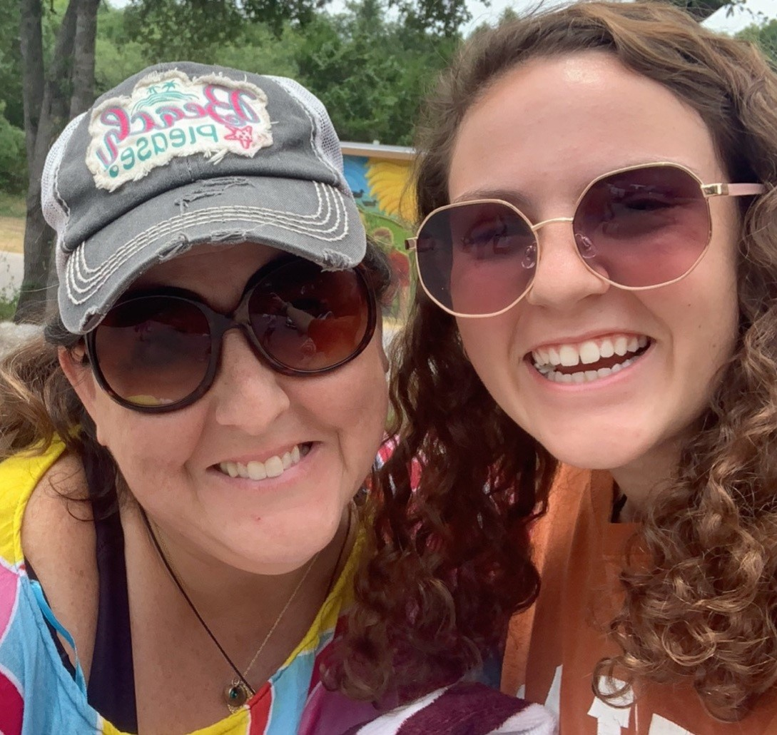
ELAR - Herrera (Koepke) Homeroom:
Class Structure:
First 45 = Reading/Vocabulary
Second 45 = Writing/LA/Spelling
Begin: Entry Ticket - questions - TLWs
Middle: Mini-Lesson - Guided Practice, Collaboration, Independent Practice, Quizzes
End: Completed work turned in OR saved to continue, Debrief, Exit Ticket, Quick Check

Slide 3
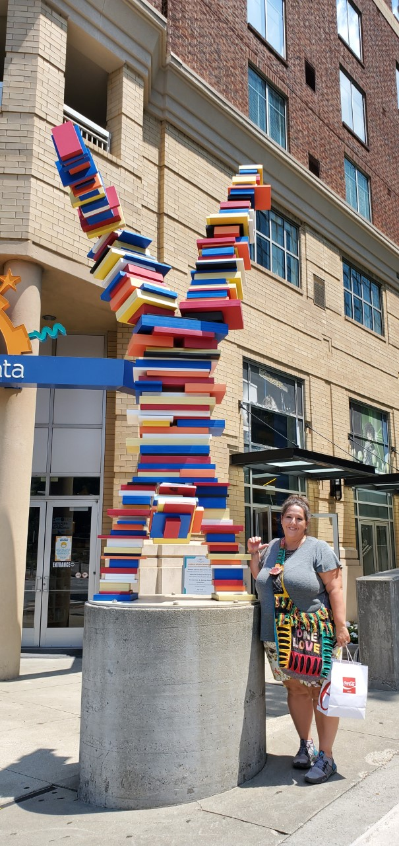
ELAR - Herrera
Materials:
ALWAYS HAVE A BOOK IN PROGRESS
WITH YOU.
Standard implements - pencil, markers,
map pencils, pen, highlighter, eraser
Composition Book (RWNB)
Folder or Small Binder (for papers and
handouts)
*BRING ALL ON-GOING WORK TO CLASS
EVERY DAY.

Slide 4
ELAR - Herrera
“WRITING/LANGUAGE”
Narrative
Persuasive
Poetry
Expository
Traits of Writing
Writing Process
RAFT
“SKILLS”
Blooms
Marzano
Analysis
Inference
Drawing Conclusions
Summarizing
Vocabulary
Theme
Main Idea & Details
Figurative Language
Text Structures
Characterization
POV
Author’s Purpose
Content:
“READING”
Genre Studies -
Poetry
Prose
Fiction
Narrative NonFiction
NonFiction
Drama
Mystery
Memoir
PADLET

